Slide 1
Dyson – AS-IS Architecture Understanding
Notes:
Note:
Dyson has their AWS accounts
The on-prem and AWS are connected through SD-WAN
They can create a new AWS account under OU but they will note share the TGW with that new account as per their company policy, So we decided to use existing account which is Non Prod RDD

Slide 2
Dyson – AS-IS Model
Networking & On-prem to AWS Connectivity
HPC & Sizing Details
Use Cases, Workstations and Sizing Details
Authentication
Success Criteria
Design/Architecture to meet the requirement
Notes:
Note:
Dyson has their AWS accounts
The on-prem and AWS are connected through SD-WAN
They can create a new AWS account under OU but they will note share the TGW with that new account as per their company policy, So we decided to use existing account which is Non Prod RDD

Slide 3
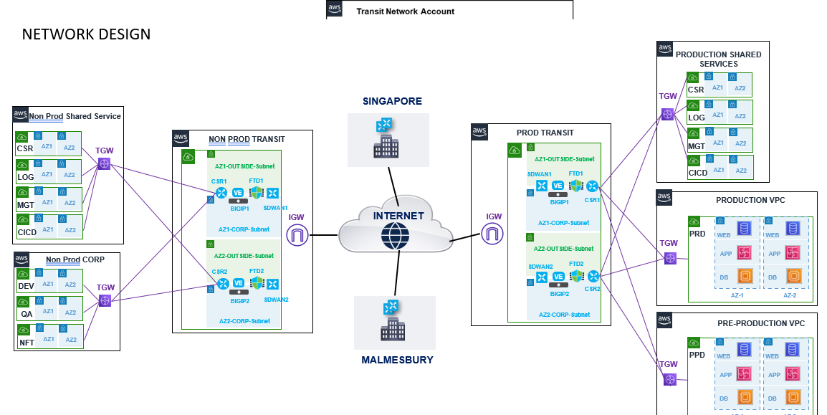



Dyson – Networking & On-Prem to AWS Connectivity
Non Prod RDD
TGW
Proposed New VPC
Notes:
Note:
Dyson has their AWS accounts
The on-prem and AWS are connected through SD-WAN
They can create a new AWS account under OU but they will note share the TGW with that new account as per their company policy, So we decided to use existing account which is Non Prod RDD

Slide 4
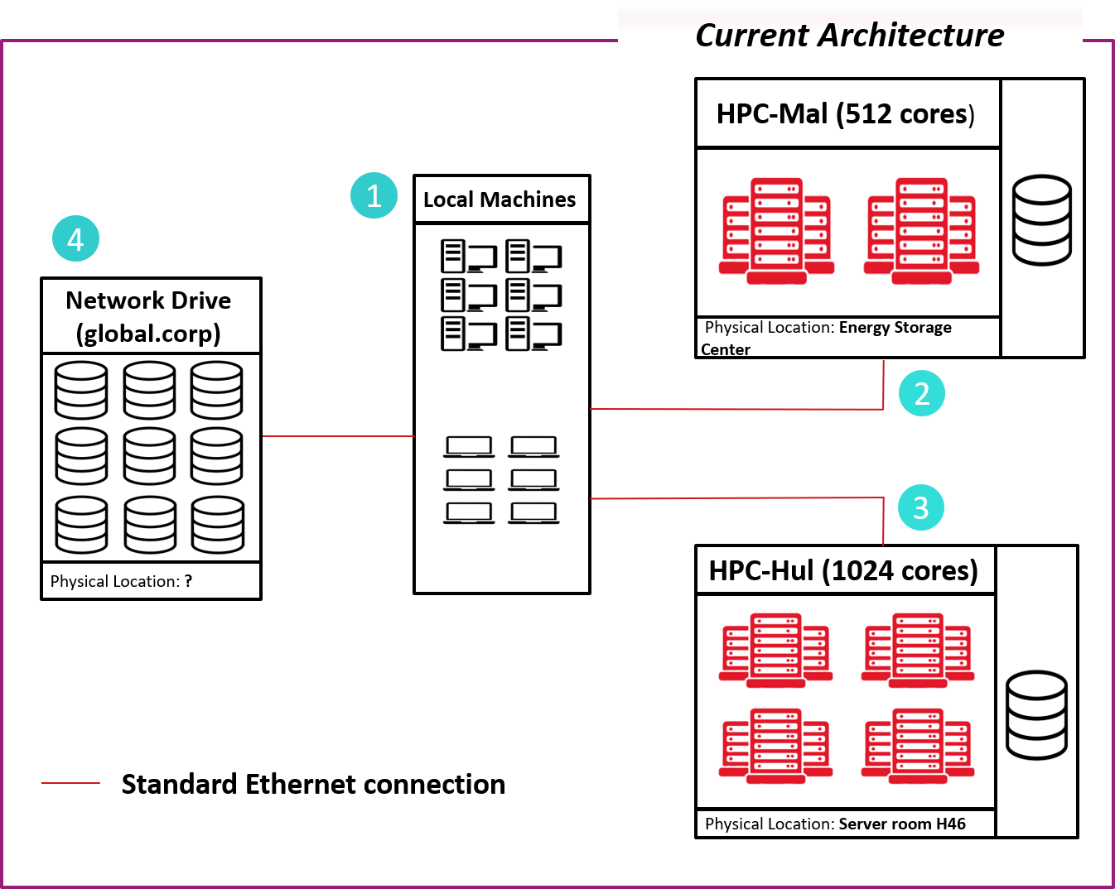
Dyson – On-prem HPC
Azure AD
Notes:
Note::
Dyson has HPC cluster in Malmesbury and Hullavington
Dyson users are using their desk to access the HPC cluster
Dyson users are logged in using the AD based on Azure-AD
Which domain they joined their workstation is yet to receive.
Users are using the NFS as their storage

Slide 5
Dyson – On-prem HPC Sizing Details
Info | HPC-01 | HPC-02
Location | Malmesbury | Hullavington
Number of Active Users | 50
Number of All Users | 100
Compute nodes
Nodes | 512 | 1024
Cores* per node | 16
CPU info | Intel(R) Xeon(R) CPU E5-2667 v2 @ 3.30GHz
RAM per node [GB] | 125
Total Storage [TB] | 3.46
Internal Connectivity | FDR InfiniBand
External Connectivity | Gigabit Ethernet up to 0.1Gbps
Master nodes
CPU info | 2 x Intel(R) Xeon(R) CPU E5-2450 v2 @ 2.50GHz | 2 x Intel(R) Xeon(R) CPU E5-2680 v2 @ 2.80GHz
Cores* | 2 x 10 | 2 x 8
RAM [GB] | 125 | 157
Notes:
Note:
Currently LSF is being used as the job scheduler in their on-prem HPC

Slide 6
Dyson – Use Case1, Workstation & Sizing Details
Use Case | System Requirement
CFD DOE Optimization (FCR) | Workstation | HPC
 | CPU: 44 RAM: 256 GB Storage: 500 GB (temporary) | CPU: 32 RAM: 64 GB Storage: 200GB/Simulation 400GB/Concurrent simulation
 | Software
 | ANSYS Workbench ANSYS OptiSLang Siemens TeamCenter Siemens NX ANSYS-NX Plugin ANSYS Meshing ANSYS Fluent ANSYS CFD Post ANSYS RSM WinScp | ANSYS Meshing ANSYS Fluent ANSYS CFD Post

Slide 7
Dyson – Use Case2, Workstation & Sizing Details
Use Case | System Requirement
Aero-Acoustic CFD (TR) | Workstation | HPC
 | CPU: 32 RAM: 128 GB Storage: 150 GB (temporary) | CPU: 256 RAM: 80 GB Storage: 150GB (temporary)
 | Software
 | ANSYS Workbench Siemens TeamCenter Siemens NX ANSYS-NX Plugin ANSYS Meshing/Fluent Meshing ANSYS Fluent ANSYS CFD Post WinScp Putty/Plink ANSYS RSM | ANSYS Meshing ANSYS Fluent Meshing ANSYS Fluent

Slide 8
Dyson – Use Case3, Workstation & Sizing Details
Use Case | System Requirement
Transient CFD Simulation (FCR) | Workstation | HPC
 | CPU: 32 RAM: 128 GB Storage: 150 GB (temporary) | CPU: 256 RAM: 80 GB Storage: 150GB (temporary)
 | Software
 | ANSYS Workbench Siemens TeamCenter Siemens NX ANSYS-NX Plugin ANSYS Meshing/Fluent Meshing ANSYS Fluent ANSYS CFD Post WinScp Putty/Plink ANSYS RSM | ANSYS Meshing ANSYS Fluent Meshing ANSYS Fluent

Slide 9
Dyson – Use Case4, Workstation & Sizing Details
Use Case | System Requirement
AeroAcoustic Dassault Systems CLOUD (Tech Research) | Workstation | HPC
 | Yet to receive | Yet to receive
 | Software
 | Yet to receive | Yet to receive

Slide 10
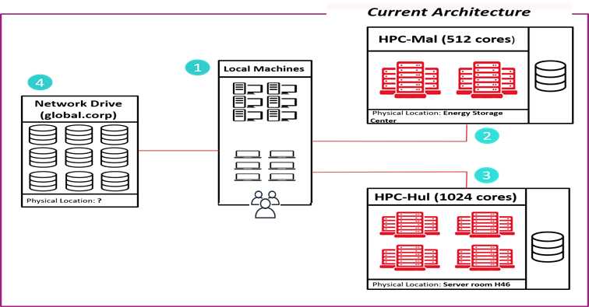










Dyson – Authentication
Azure AD
VPN Solution
Customer Gateway
_{Master Account}
TCS Dev Center
_{Roles}
_{Policies}
_{AWS SSO}
Engineer with Dyson Laptop
Client VPN
SD-WAN
_{Sub Account -1}
_{Sub Account -2}
Notes:
Note:
Dyson has their AWS accounts
The on-prem and AWS are connected through SD-WAN
Azure AD is being used for the AD which is already integrated with Master A/C’s SSO, and the SSO based validation is being done for the other sub accounts
Which domain they joined their workstation is yet to receive.

Slide 11
Dyson – Success Criteria
1 | Connection speed from Dyson to virtual workstation has to be satisfactory
2 | Users should be able to select different size of workstation up to 32 cores and 256GB RAM
3 | User should easily Hybernate/Dehybernate their workstations
4 | File transfer from Dyson to AWS platform and back at least 100MBps (ideally >200MBps)
5 | File transfer between virtual workstation and compute node has to be >1GBps
6 | HPC speed should be at least same compared the current HPC for CFD test case
7 | Platform should be scalable with number of CPUs in the same way as on the current HPC
8 | System should handle traffic with up to 100 users remoting from Dyson to the platform
9 | User should connect to Dyson network drives
10 | User should check out Dyson software licenses
11 | Data storage should be backed up for workstations and HPC
12 | HPC speed should be 1.5x better than the current HPC for CFD test case
13 | User should access software versions aligned with current usage at Dyson
14 | Automated ANSYS Workflow: User should connect from dyson to the HPC via RSM
15 | Simple ANSYS Simulation: User should be able to execute the given uses cases in VW and HPC
16 | PowerFLOW Workflow: User should be able to run benchmark DDM motor PowerFLOW sim on HPC up to 256 cores/max HPC cores. Check wall-clock / Validity of results
17 | PowerFLOW Workflow: User should be able to run automated post-processing of benchmark DDM case on Virtual workstation
Notes:
Note:
Dyson has their AWS accounts
The on-prem and AWS are connected through SD-WAN
They can create a new AWS account under OU but they will note share the TGW with that new account as per their company policy, So we decided to use existing account which is Non Prod RDD

Slide 12
Dyson – To-Be Model
Advice and proposal
SOCA vs AWS Parallel Cluster – Parallel Cluster has been finalized
Job Scheduler: LSF vs PBS vs Slurm
AWS SSO integration, Domain join
Connectivity between on-prem and AWS
Storage: FSx vs EFS
Head Node, Compute Node, Workstation Node
Performance
Network Performance, Latency
Compute Node Performance
Workstation Performance
EFA

Slide 13
Dyson To-Be Model – Compute, Sizing, Authentication Details
Service type | Description | Qty
Compute Node | c6i.32xlarge: RHEL, 128 vCPU, 256 GiB RAM, Support EFA | On-demand
Head / Login Node | hpc6a.48xlarge:RHEL, 128 vCPU, 512 GiB RAM, Support EFA | 1
EnginFrame Portal Node | m5.24xlarge: RHEL, 96 vCPU, 384 GiB RAM | 1
Workstation | g4dn.2xlarge: Windows: 32 vCPU, 128 GiB RAM, 900 GB Local Storage | 2
Storage Accounts | FSx for Netapp Ontap | 150TB
Backup | FSx backup
Other Features | SD-WAN, AWS KMS, CloudWatch, AWS IAM As per requirement
Authentication | Azure AD and AWS SSO will be used for authentication
Scheduler | Existing: LSF, Proposed: PBS/Slurn | 1

Slide 14
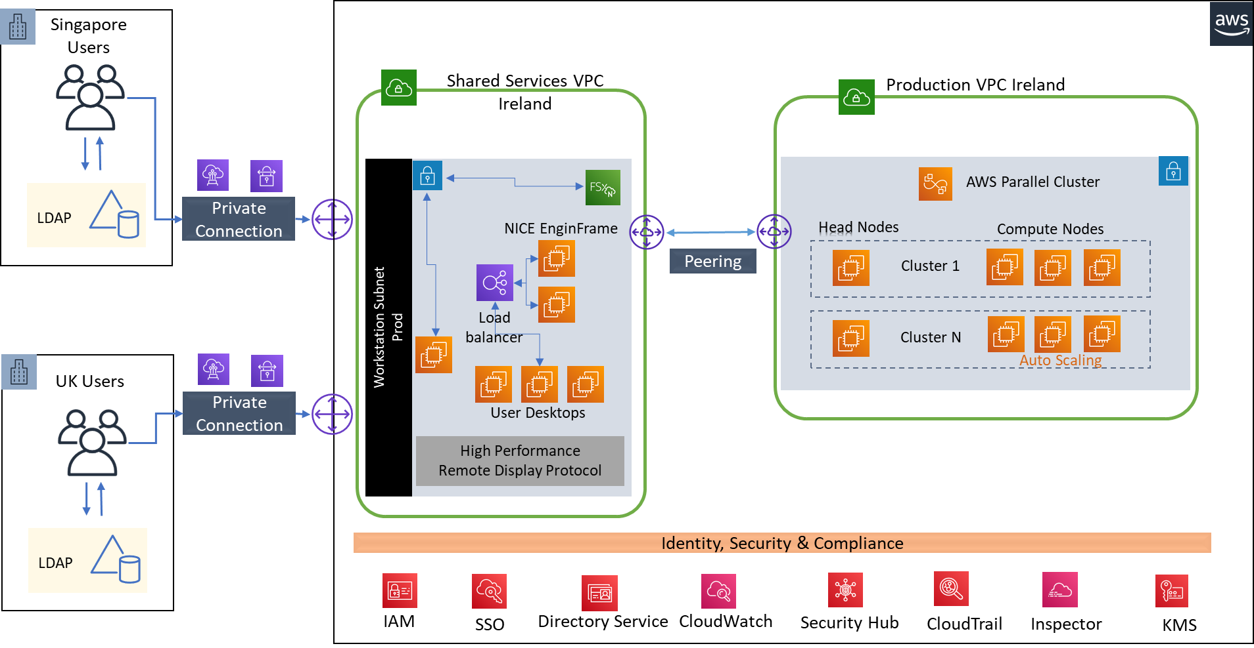
Dyson To-Be – High Level Architecture Diagram using Parallel Cluster (Reference Architecture)
Notes:
Note:
Can you skip the LoadBalancer in PoC phase?

Slide 15






Dyson To-Be – AWS Connectivity with On-prem and TCS Development Center
Ireland Region
Transit Account
NPR RDD Account
Dyson Malmesbury
Transit VPC
HPC-VPC
Corp Subnet
Internet Gateway
Cisco CSR
Transit
Gateway
Other-VPC
End Users
Customer Gateway
SD-WAN
AZ-1
AZ-2
Ireland Region
Dyson Malmesbury
Transit Account
NPR RDD Account
Transit VPC
HPC-VPC
TCS Dev Center
User
Corp Subnet
Cloud Engineer with Dyson Laptop
Other-VPC
VPN Solution
Internet Gateway
Cisco CSR
Transit
Gateway
SD-WAN
AZ-1
AZ-2
Client VPN
Notes:
Question to Steve/Aruneet:
Can we install the entire SOCA cluster in private subnet including the head node? By changing the script
How can we change the Head Node configuration in case we need a higher sizing? By changing the script
How to create and use FSx Luster storage as the file system for the SOCA? By changing the script
How can we authenticate user’s credential based on the Azure AD (i.e. Current Dyson is using for their on-prem user)? By changing the script
Certificate Mgr can be associated later.

Slide 16

















Dyson To-Be – High Level Architecture Diagram using AWS Parallel Cluster – Multi-AZ
Dyson Malmesbury
Ireland Region
RDD A/C
AZ-1
AZ-2
AZ-3
Transit Account
Private subnet1
Private subnet2
Private subnet3
User
On-prem Servers
HPC
VPN Solution
Internet Gateway
Cloud9
Workstation-1 (Windows)
Workstatio-2 (Windows)
Customer Gateway
Corp Subnet
Client VPN
TGW
Head Node (CentOS 7)
Workstation-3 (Windows)
Workstation-4 (Windows)
Cisco CSR
Scheduler
SD-WAN
C6i.2xlarge
TCS Dev Center
Compute Nodes
Compute Nodes
Compute Nodes
Cloud Engineer with Dyson Laptop
Job Queues
Compute Nodes
Compute Nodes
Compute Nodes
Cloud9 is used for deployment purpose in PoC phase
HPC Instance Type
Compute: C6i.32xlarge
Head: C6i.2xlarge
Workstations
G4dn.8xlarge
Storage
Local 1 TB GP3
Shared 20 TB FSx for NetApp ONTAP
Compute Nodes
Compute Nodes
Compute Nodes
Security Groups
sg-hpc-poc-cloud9
sg-hpc-poc-workstation
sg-hpc-poc-head-node
sg-hpc-poc-compute
Storage Options
Identity, Security & Compliance
S3
FSx for ONTAP
IAM
SSO
Dir Service
Secrets Mgr
CloudWatch
Security Hub
CloudTrail
Inspector
KMS
Notes:
Note:
The total cluster will be created in private subnets spanning across three AZs
Workstations, HeadNode will be connected to On-Prem network though SD-WAN, TGW and Domain join
Workstations: Windows 10, HeadNode: Ubuntu 20.04, On-Demand compute Node: ???
FSx Luster storage will be used
Job Scheduler Slurm will be used, however LSF is preferred
How many Job queues we should have?
Do we have any interface (i.e. similar to SOCA) to create the Workstation?
Is only One HeadNode is sufficient in the PoC phase?
Can we make it a single region, 3 AZ, without the LoadBalancer in PoC phase?
Onprem connectivity and Domain Join is required to connect the On-prem License server, NFS, PLM server
How to create the Nodes considering the Dyson domain join security requirement
What should be CIDR ranges? Is 255 IP range is OK for the PoC?
How many maximum compute node we are expecting to complete the given use cases, based on that we can ask Dyson to allow the CIDR ranges
How to do we scan the compute nodes against Qualys if that will come as a mandate?

Slide 17
Dyson To-Be – High Level Architecture Diagram using AWS Parallel Cluster – Single AZ
Dyson Malmesbury
Ireland Region
RDD NPR A/C
eu-west-1a
Transit Account
rdd-npr-hpc-1a-sn1
User
On-prem Servers
HPC
sg-hpc-poc-cloud9
sg-hpc-poc-head-node
sg-hpc-poc-workstation-node
VPN Solution
Internet Gateway
Head Node (CentOS 7)
Workstation-1 (Windows)
Workstation-2 (Windows)
Cloud9
Scheduler
Customer Gateway
C6i.2xlarge
Corp Subnet
Client VPN
Cisco CSR
TGW
sg-hpc-poc-compute-node
Workstation-3 (Windows)
Workstation-4 (Windows)
SD-WAN
Compute Nodes
TCS Dev Center
Job Queues
Compute Nodes
Cloud Engineer with Dyson Laptop
Cloud9 is used for deployment purpose in PoC phase
HPC Instance Type
Compute: C6i.32xlarge
Head: C6i.2xlarge
Workstations
G4dn.8xlarge
Storage
Local 1 TB GP3
Shared 20 TB FSx for NetApp ONTAP
Compute Nodes
FSx NetApp for ONTAP
Security Groups
sg-hpc-poc-cloud9
sg-hpc-poc-workstation
sg-hpc-poc-head-node
sg-hpc-poc-compute
Storage Options
Identity, Security & Compliance
S3
FSx for ONTAP
IAM
SSO
Dir Service
Secrets Mgr
CloudWatch
Security Hub
CloudTrail
Inspector
KMS
Notes:
Note:
The total cluster will be created in private subnets spanning across three AZs
Workstations, HeadNode will be connected to On-Prem network though SD-WAN, TGW and Domain join
Workstations: Windows 10, HeadNode: Ubuntu 20.04, On-Demand compute Node: ???
FSx Luster storage will be used
Job Scheduler Slurm will be used, however LSF is preferred
How many Job queues we should have?
Do we have any interface (i.e. similar to SOCA) to create the Workstation?
Is only One HeadNode is sufficient in the PoC phase?
Can we make it a single region, 3 AZ, without the LoadBalancer in PoC phase?
Onprem connectivity and Domain Join is required to connect the On-prem License server, NFS, PLM server
How to create the Nodes considering the Dyson domain join security requirement
What should be CIDR ranges? Is 255 IP range is OK for the PoC?
How many maximum compute node we are expecting to complete the given use cases, based on that we can ask Dyson to allow the CIDR ranges
How to do we scan the compute nodes against Qualys if that will come as a mandate?

Slide 18
Dyson To-Be – High Level Architecture Diagram using AWS Parallel Cluster – Two AZ
Dyson Malmesbury
Ireland Region
RDD PRD A/C
eu-west-1a
Transit Account
rdd-prd-hpc-euw1-1a-sn1
rdd-prd-hpc-euw1-1b-sn1
User
On-prem Servers
HPC
sg-rdd-prd-hpc-euw1-workstation
sg-hpc-head-node
Workstations (Windows)
Internet Gateway
Workstations (Windows)
Head Node (CentOS 7)
VPN Solution
Customer Gateway
Scheduler
C6i.2xlarge
Corp Subnet
sg-rdd-prd-hpc-euw1-fsx
Client VPN
TGW
Cisco CSR
FSx NetApp for ONTAP
SD-WAN
sg-hpc-compute-node
TCS Dev Center
Compute Nodes
Compute Nodes
Cloud Engineer with Dyson Laptop
Job Queues
Compute Nodes
Compute Nodes
Compute Nodes
Compute Nodes
HPC Instance Type
Compute: C6i.32xlarge
Head: C6i.2xlarge
Workstations
G4dn.2xlarge
Storage
Local 600 BB GP3
Shared 20 TB FSx for NetApp ONTAP
sg-rdd-prd-hpc-euw1-workstation
sg-hpc-head-node
sg-hpc-compute
sg-rdd-prd-hpc-euw1-fsx
Security Groups
Storage Options
Identity, Security & Compliance
S3
FSx for ONTAP
IAM
SSO
Dir Service
Secrets Mgr
CloudWatch
Security Hub
CloudTrail
Inspector
KMS
Notes:
Note:
The total cluster will be created in private subnets spanning across three AZs
Workstations, HeadNode will be connected to On-Prem network though SD-WAN, TGW and Domain join
Workstations: Windows 10, HeadNode: Ubuntu 20.04, On-Demand compute Node: ???
FSx Luster storage will be used
Job Scheduler Slurm will be used, however LSF is preferred
How many Job queues we should have?
Do we have any interface (i.e. similar to SOCA) to create the Workstation?
Is only One HeadNode is sufficient in the PoC phase?
Can we make it a single region, 3 AZ, without the LoadBalancer in PoC phase?
Onprem connectivity and Domain Join is required to connect the On-prem License server, NFS, PLM server
How to create the Nodes considering the Dyson domain join security requirement
What should be CIDR ranges? Is 255 IP range is OK for the PoC?
How many maximum compute node we are expecting to complete the given use cases, based on that we can ask Dyson to allow the CIDR ranges
How to do we scan the compute nodes against Qualys if that will come as a mandate?

Slide 19

Dyson To-Be – High Level Architecture Diagram using AWS Parallel Cluster – Two AZ, Four Subnet
Dyson Malmesbury
Ireland Region
RDD PRD A/C
eu-west-1a
eu-west-1b
Transit Account
rdd-prd-hpc-euw1-1a-sn1
rdd-prd-hpc-euw1-1b-sn1
User
On-prem Servers
sg-rdd-prd-hpc-euw1-workstation
sg-hpc-head-node
sg-hpc-head-node
HPC
Internet Gateway
Workstations (Windows)
Head Node-1(RHEL)
Head Node-2(RHEL)
VPN Solution
Customer Gateway
Scheduler
Scheduler
C6i.2xlarge
C6i.2xlarge
Corp Subnet
sg-rdd-prd-hpc-euw1-fsx
Client VPN
TGW
Cisco CSR
Job Queues
FSx NetApp for ONTAP
Job Queues
SD-WAN
sg-hpc-compute-node
sg-hpc-compute-node
TCS Dev Center
Compute Nodes
Compute Nodes
Cloud Engineer with Dyson Laptop
Compute Nodes
Compute Nodes
One Parallel Cluster Per AZ
HPC Instance Type
Compute: C6i.32xlarge
Head: C6i.2xlarge
Workstations
G4dn.2xlarge
Storage
Local 600 GB GP3
Shared 50 TB FSx for NetApp ONTAP
Compute Nodes
Compute Nodes
sg-hpc-workstation
sg-hpc-head-node
sg-hpc-compute
sg-hpc-fsx
Security Groups
Storage Options
Identity, Security & Compliance
S3
FSx for ONTAP
IAM
SSO
Dir Service
Secrets Mgr
CloudWatch
Security Hub
CloudTrail
Inspector
KMS
Notes:
Note:
The total cluster will be created in private subnets spanning across three AZs
Workstations, HeadNode will be connected to On-Prem network though SD-WAN, TGW and Domain join
Workstations: Windows 10, HeadNode: Ubuntu 20.04, On-Demand compute Node: ???
FSx Luster storage will be used
Job Scheduler Slurm will be used, however LSF is preferred
How many Job queues we should have?
Do we have any interface (i.e. similar to SOCA) to create the Workstation?
Is only One HeadNode is sufficient in the PoC phase?
Can we make it a single region, 3 AZ, without the LoadBalancer in PoC phase?
Onprem connectivity and Domain Join is required to connect the On-prem License server, NFS, PLM server
How to create the Nodes considering the Dyson domain join security requirement
What should be CIDR ranges? Is 255 IP range is OK for the PoC?
How many maximum compute node we are expecting to complete the given use cases, based on that we can ask Dyson to allow the CIDR ranges
How to do we scan the compute nodes against Qualys if that will come as a mandate?

Slide 20
Change from PoC to Prod
System Change
Area | PoC | Prod
Base Infrastructure | New VPC, One AZ, One Subnet | New VPC, Two AZ, Two Subnet
Parallel Cluster | CentOS based | RHEL based
Shared Storage | FSx with single AZ, 20 TB, 256 MBps | FSx with multi AZ, 50 TB, 512 MBps
Security Groups | Everything Open from 10.0.0.0/8 | Specific IP, Port to open from London and Singapore IP breakout
Workstation Security | All allowed from 10.0.0.0/8 | RDP, SSH, DCV allowed from Singapore RDP, SSH, DCV allowed from London
FSx Security | All allowed from 10.0.0.0/8 | Only members from AD group From London and Singapore
Deployment | Console + Cloud9 | TF Script

Slide 21

Dyson To-Be – Inter-Connectivity within the AWS Parallel Cluster – Multi AZ
DCV Client
Ireland Region
RDD NPR A/C
AZ-1
AZ-2
AZ-3
Private subnet1
Private subnet2
Private subnet3
Business User
HPC
Cloud9
Head Node (CentOS 7)
Submit Job
Data Connectivity
Scheduler,
Send to Queue
C6i.2xlarge
TGW
Workstation (Windows)
NICE DCV Server
DCV Session
DCV Session
G4dn.8xlarge
Data
Data Connectivity
Compute Nodes
Compute Nodes
Compute Nodes
Job Queues
Compute Nodes
Compute Nodes
Compute Nodes
Compute Nodes
Compute Nodes
Compute Nodes
Identity, Security & Compliance
Data Upload
Security Hub
Inspector
KMS
S3
FSx for ONTAP
IAM
SSO
Dir Service
Secrets Mgr
CloudWatch
CloudTrail
Notes:
Note:
The total cluster will be created in private subnets spanning across three AZs
Workstations, HeadNode will be connected to On-Prem network though SD-WAN, TGW and Domain join
Workstations: Windows 10, HeadNode: Ubuntu 20.04, On-Demand compute Node: ???
FSx Luster storage will be used
Job Scheduler Slurm will be used, however LSF is preferred
How many Job queues we should have?
Do we have any interface (i.e. similar to SOCA) to create the Workstation?
Is only One HeadNode is sufficient in the PoC phase?
Can we make it a single region, 3 AZ, without the LoadBalancer in PoC phase?
Onprem connectivity and Domain Join is required to connect the On-prem License server, NFS, PLM server
How to create the Nodes considering the Dyson domain join security requirement
What should be CIDR ranges? Is 255 IP range is OK for the PoC?
How many maximum compute node we are expecting to complete the given use cases, based on that we can ask Dyson to allow the CIDR ranges
How to do we scan the compute nodes against Qualys if that will come as a mandate?

Slide 22
Dyson To-Be – Inter-Connectivity within the AWS Parallel Cluster – Single AZ
Dyson on-premise
Ireland Region
DCV Client
HPC
Workstations
NICE DCV Server
Head Node
Submit Job
Slurm Scheduler
CentOS 7,
Users
DCV Session
TGW
DCV Session
Data Connectivity
FSx for ONTAP
Send to Queue
Job Queues
Compute Nodes
Compute Nodes
Compute Nodes
Compute Nodes
Compute Nodes
Compute Nodes
Identity, Security & Compliance
IAM
SSO
Dir Service
Secrets Mgr
CloudWatch
CloudTrail
KMS
Notes:
Note:
The total cluster will be created in private subnets spanning across three AZs
Workstations, HeadNode will be connected to On-Prem network though SD-WAN, TGW and Domain join
Workstations: Windows 10, HeadNode: Ubuntu 20.04, On-Demand compute Node: ???
FSx Luster storage will be used
Job Scheduler Slurm will be used, however LSF is preferred
How many Job queues we should have?
Do we have any interface (i.e. similar to SOCA) to create the Workstation?
Is only One HeadNode is sufficient in the PoC phase?
Can we make it a single region, 3 AZ, without the LoadBalancer in PoC phase?
Onprem connectivity and Domain Join is required to connect the On-prem License server, NFS, PLM server
How to create the Nodes considering the Dyson domain join security requirement
What should be CIDR ranges? Is 255 IP range is OK for the PoC?
How many maximum compute node we are expecting to complete the given use cases, based on that we can ask Dyson to allow the CIDR ranges
How to do we scan the compute nodes against Qualys if that will come as a mandate?

Slide 23
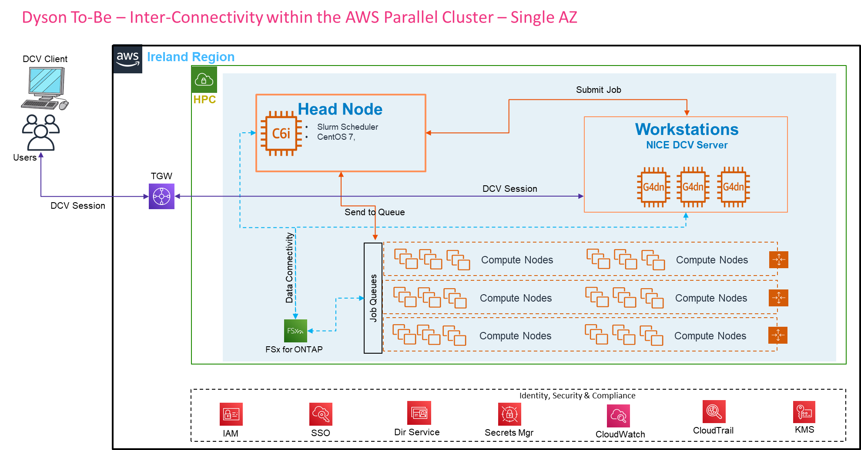

Slide 24
Dyson To-Be – Inter-Connectivity within the AWS Parallel Cluster – Two AZ
Dyson on-premise
Ireland Region
DCV Client
Workstations (Windows)
Head Node (RHEL)
Head Node (RHEL)
HPC
Submit Job
Scheduler
C6i.2xlarge
Scheduler
C6i.2xlarge
Users
Data Connectivity
TGW
DCV Session
Send to Queue
Send to Queue
DCV Session
FSx for ONTAP
Job Queues
Job Queues
Compute Nodes
Compute Nodes
Compute Nodes
Compute Nodes
Compute Nodes
Compute Nodes
Identity, Security & Compliance
IAM
SSO
Dir Service
Secrets Mgr
CloudWatch
CloudTrail
KMS
Notes:
Note:
The total cluster will be created in private subnets spanning across three AZs
Workstations, HeadNode will be connected to On-Prem network though SD-WAN, TGW and Domain join
Workstations: Windows 10, HeadNode: Ubuntu 20.04, On-Demand compute Node: ???
FSx Luster storage will be used
Job Scheduler Slurm will be used, however LSF is preferred
How many Job queues we should have?
Do we have any interface (i.e. similar to SOCA) to create the Workstation?
Is only One HeadNode is sufficient in the PoC phase?
Can we make it a single region, 3 AZ, without the LoadBalancer in PoC phase?
Onprem connectivity and Domain Join is required to connect the On-prem License server, NFS, PLM server
How to create the Nodes considering the Dyson domain join security requirement
What should be CIDR ranges? Is 255 IP range is OK for the PoC?
How many maximum compute node we are expecting to complete the given use cases, based on that we can ask Dyson to allow the CIDR ranges
How to do we scan the compute nodes against Qualys if that will come as a mandate?

Slide 25
Dyson To-Be – Sizing Details
System requirements for PoC
Sl. No | Description | Environment | Instance Type | vCPU | RAM (GB) | Disk (GB)
1 | Head Node | NPR RDD | C6i.2xlarge | 128 | 256 | 1024
2 | Workstation-1 | NPR RDD | G4dn.16xlarge | 64 | 256 | 600
3 | Workstation-2 | NPR RDD | G4dn.8xlarge | 32 | 128 | 600
4 | Workstation-3 | NPR RDD | G4dn.8xlarge | 32 | 128 | 600
5 | Workstation-4 | NPR RDD | G4dn.8xlarge | 32 | 128 | 600
6 | Compute Node | NPR RDD | C6i.32xlarge | 128 | 256 | 1024

Slide 26
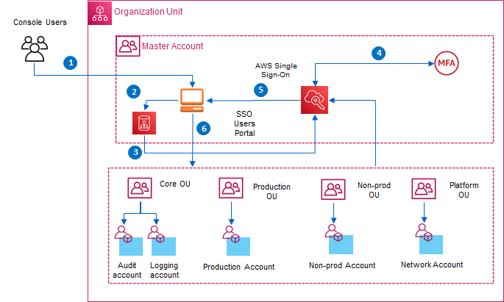
Dyson To-Be – AWS SSO Authentication Flow
Notes:
Note:
Can you skip the LoadBalancer in PoC phase?

Slide 27
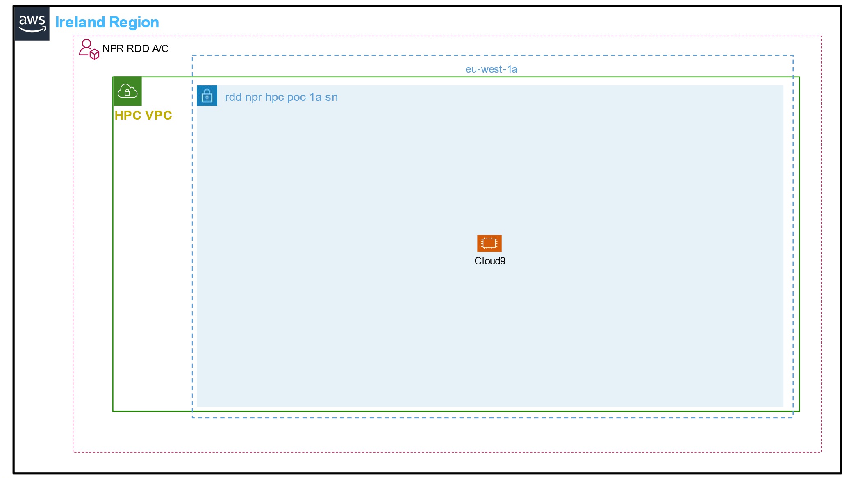
Dyson To-Be – Implementation
Terraform Script
1
Cloud Engineer
Install Pre-requisites
a
Create SSH Key
b
Create the Config
c
2
Create Head Node
d
Cloud9
Configure the Cluster
e
Cloud Engineer
Create Workstation
f
Configure the WS
g
Workstation (Windows)
HPC Cluster
3
Scheduler,
NICE DCV
Storage, Compute
Job Queues
G4dn.8xlarge
Users

Slide 28
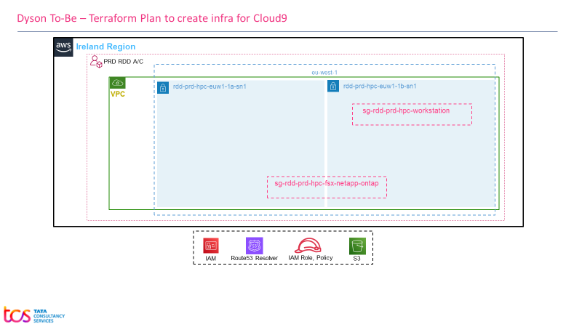
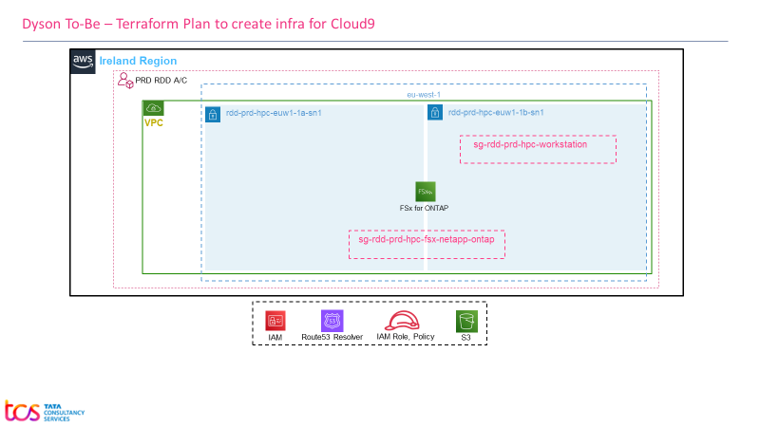
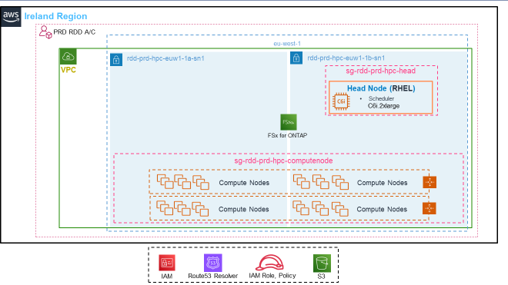
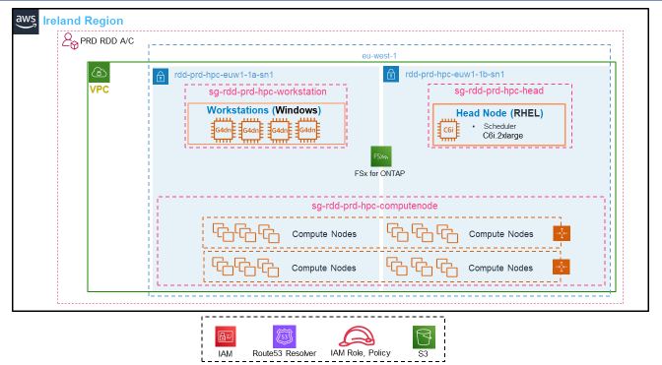
Dyson To-Be – Implementation
Terraform Script
1
vpc, subnet, sg, key-pair, role, policy
Base Infrastructure
Cloud Engineer
2
Fsx NetApp ONTAP
FSx Installed & Configured
Cloud Engineer
3
AWS Parallel Cluster
Parallel Cluster Installed and Configured
Cloud Engineer
4
Create Workstation (EC2 Instance)
Parallel Cluster Installed and Configured
Cloud Engineer

Slide 29
Dyson To-Be – Security Rules
Notes:
Note:
Can you skip the LoadBalancer in PoC phase?

Slide 30



Dyson To-Be – Security Group
Singapore Users
London Users
Map Storage
RDP & DCV
SSH
SSH
RDP &, DCV
Submit Job
Workstations
Head Node
Compute Nodes
Map Storage
Mount Storage
All Traffic
FSx for ONTAP
Domain Join
Domain Join
LDAP
/AD
Directory Service Integration
Data Request
RDP, DCV Request
SSH Request
LDAP Request
On-prem Request
Submit Job
LDAP/AD
On-Prem Servers
HPC Apps Connects to on-prem servers
HPC Apps Connects to on-prem servers
Notes:
Note:
Can you skip the LoadBalancer in PoC phase?

Slide 31
Dyson To-Be – Terraform Plan to create infra for Cloud9
Ireland Region
NPR RDD A/C
eu-west-1a
rdd-npr-hpc-poc-1a-sn
HPC VPC
Cloud9
Notes:
Note:
The total cluster will be created in private subnets spanning across three AZs
Workstations, HeadNode will be connected to On-Prem network though SD-WAN, TGW and Domain join
Workstations: Windows 10, HeadNode: Ubuntu 20.04, On-Demand compute Node: ???
FSx Luster storage will be used
Job Scheduler Slurm will be used, however LSF is preferred
How many Job queues we should have?
Do we have any interface (i.e. similar to SOCA) to create the Workstation?
Is only One HeadNode is sufficient in the PoC phase?
Can we make it a single region, 3 AZ, without the LoadBalancer in PoC phase?
Onprem connectivity and Domain Join is required to connect the On-prem License server, NFS, PLM server
How to create the Nodes considering the Dyson domain join security requirement
What should be CIDR ranges? Is 255 IP range is OK for the PoC?
How many maximum compute node we are expecting to complete the given use cases, based on that we can ask Dyson to allow the CIDR ranges
How to do we scan the compute nodes against Qualys if that will come as a mandate?

Slide 32


Dyson To-Be – Terraform Plan to create infra for Cloud9
Ireland Region
PRD RDD A/C
eu-west-1
rdd-prd-hpc-euw1-1a-sn1
rdd-prd-hpc-euw1-1b-sn1
VPC
sg-rdd-prd-hpc-workstation
sg-rdd-prd-hpc-head
Workstations (Windows)
Head Node (RHEL)
Scheduler
C6i.2xlarge
FSx for ONTAP
sg-rdd-prd-hpc-computenode
Compute Nodes
Compute Nodes
Compute Nodes
Compute Nodes
IAM
Route53 Resolver
IAM Role, Policy
S3
Notes:
Note:
The total cluster will be created in private subnets spanning across three AZs
Workstations, HeadNode will be connected to On-Prem network though SD-WAN, TGW and Domain join
Workstations: Windows 10, HeadNode: Ubuntu 20.04, On-Demand compute Node: ???
FSx Luster storage will be used
Job Scheduler Slurm will be used, however LSF is preferred
How many Job queues we should have?
Do we have any interface (i.e. similar to SOCA) to create the Workstation?
Is only One HeadNode is sufficient in the PoC phase?
Can we make it a single region, 3 AZ, without the LoadBalancer in PoC phase?
Onprem connectivity and Domain Join is required to connect the On-prem License server, NFS, PLM server
How to create the Nodes considering the Dyson domain join security requirement
What should be CIDR ranges? Is 255 IP range is OK for the PoC?
How many maximum compute node we are expecting to complete the given use cases, based on that we can ask Dyson to allow the CIDR ranges
How to do we scan the compute nodes against Qualys if that will come as a mandate?

Slide 33
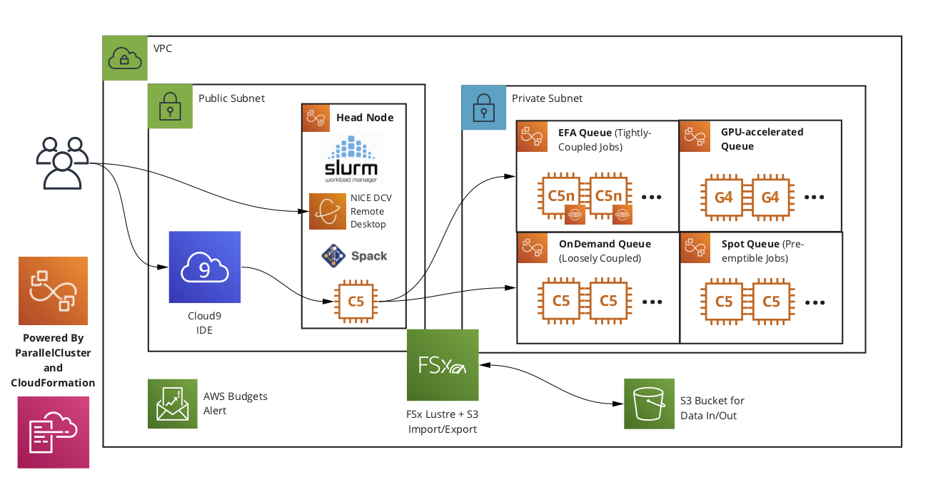
Dyson To-Be – High Level Architecture Diagram using AWS Parallel Cluster (AWS Reference Architecture)

Slide 34






Dyson – High level Architecture Diagram with Multi-Account
TCS Dev Center
Ireland Region
Transit Account
Production Account
Client VPN
Internet Gateway
VPC-HPC-Prod
Malmesbury
AZ-1
AZ-2
AZ-3
LDAP
/AD
Public subnet
Public subnet
Public subnet
LDAP/AD
SD-WAN
Corp Subnet
TGW
NAT GW
Head Node
Head Node
NAT GW
NAT GW
Head Node
Internet
Private subnet
Private subnet
Private subnet
Cisco CSR
Workstation
Cloud9
Workstation
Workstation
Connectivity
SD-WAN, Client VPN are connected to IGW
IGW, Cisco CSR deployed in Transit A/C
VPCs are connected through TGW & CSR
Authentication
AWS SSO based authentication
AWS SSO is integrated with MS AD
Domain join
Connect Workstations
Log-on to SSO Portal, then AWS Mgmt console, then Session Mgr to connect to Workstation
Alternatively, user can RDP to Workstations
Workflow
Users get into their Workstation
Browse the Head-Node Web Portal Load Balancer url, or Open the DCV session
The users will post job, and can visualize remotely via NICE DCV
NICE DCV
NICE DCV
NICE DCV
Compute Nodes
Compute Nodes
Compute Nodes
Two-Way Trust
NPR RDD Account
Test Account
TGW
TGW
VPC-HPC-Dev
VPC-HPC-Test
AZ-1
AZ-2
AZ-1
AZ-2
Master Account
Head Node
Public subnet
Public subnet
Public subnet
Scheduler
Web Portal
Analytical Dashboard
Shared subnet from Network Account
NAT GW
NAT GW
NAT GW
Head Node
Head Node
Private subnet
Private subnet
Private subnet
POC Scope
Infrastructure creation for PoC
Leverage existing AWS Landing Zone
Leverage existing Active Directory, Domain
Data upload/migration & App deployment
Use case validation
Workstation
Workstation
Cloud9
AWS Managed AD
NICE DCV
NICE DCV
Workstation
Workstation
NICE DCV
NICE DCV
Cloud9
AWS SSO
Compute Nodes
Compute Nodes
Compute Nodes
Compute Nodes

